Slide 1
Digital Electronics and Systems

Slide 2
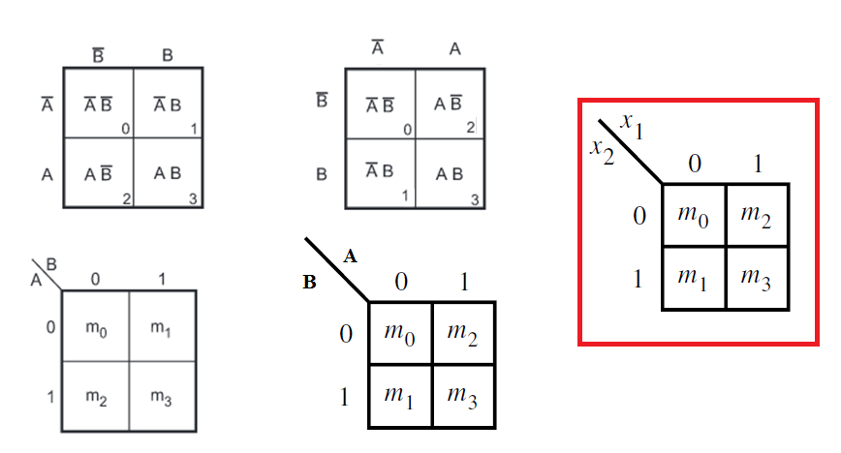
Various representations of Karnaugh Map
2 variable representation

Slide 3
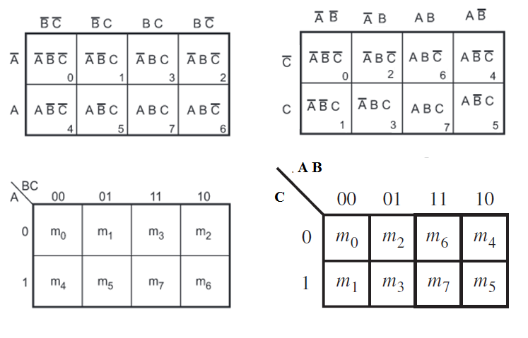
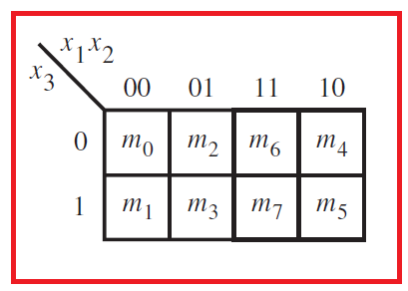
3 variable representation

Slide 4
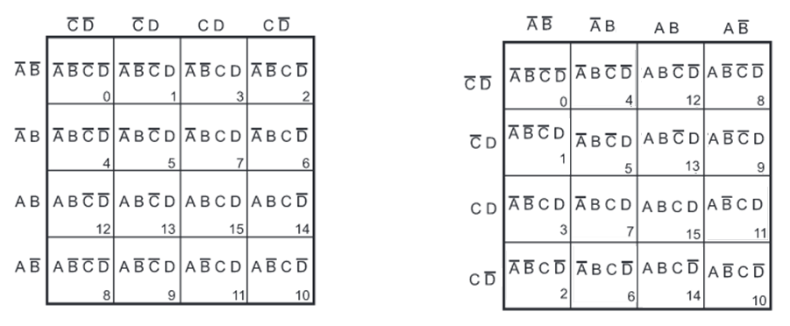
4 variable representation

Slide 5
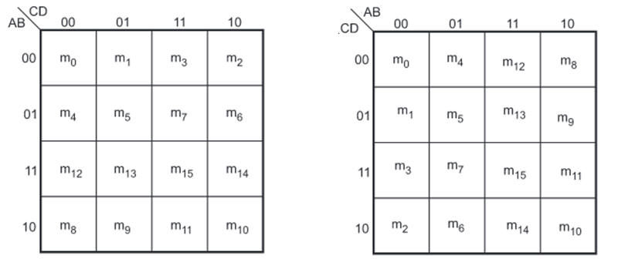
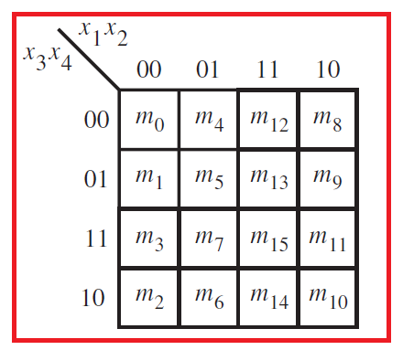
4 variable representation

Slide 6
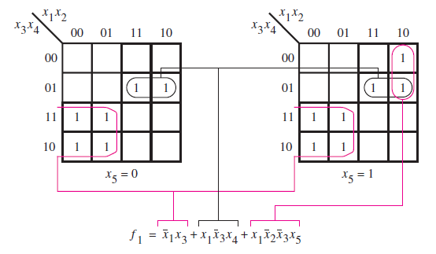
5 variable K-map
Two four variable maps are used to construct 5 variable K-map.

Slide 7
Terminology
Implicant : Implicant is a product/minterm term in Sum of Products (SOP) or sum/maxterm term in Product of Sums (POS) of a Boolean function.
Consider a Boolean function, F = AB + ABC + BC.
Implicants are AB, ABC and BC.

Slide 8
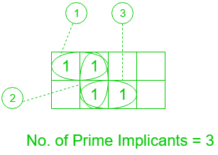
Prime Implicants : A group of square or rectangle made up of bunch of adjacent minterms which is allowed by definition of K-Map are called prime implicants(PI) i.e. all possible groups formed in K-Map.

Slide 9
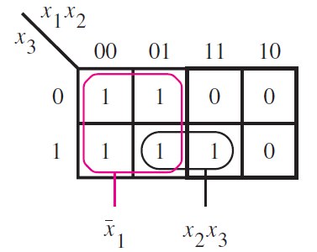


Cover: A cover defines particular implementation of the function.

Slide 10
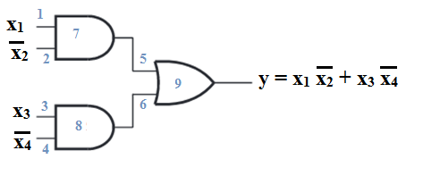
Cost : Cost of a logic circuit is the number of gates plus the total number of inputs to all gates in the circuit.
Assume primary variables, are available in both normal and complemented forms at zero cost.

Slide 11

Simplification of Sum of Products expression
Simplify the following expression using the Karnaugh map
for the 4 variables x_{1,} x₂ , x₃ and x₄ .

Slide 12
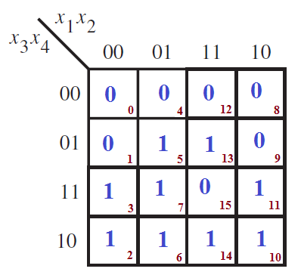
Step 1: Construct the K-map and enter 1 in the cells corresponding to the minterms present in the expression and 0 in the other cells.

Slide 13
Step 2: Check the K-map for the adjacent 1’s and encircle those 1’s which are not adjacent to any other 1’s. These are called isolated 1’s.
Here no isolated 1’s.

Slide 14
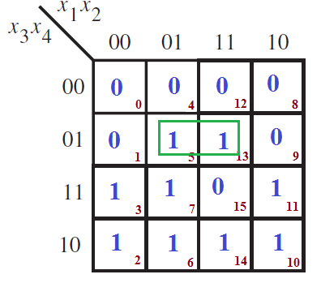
Step 3: Check for those 1’s which are adjacent to only one other 1 and encircle such pairs.

Slide 15
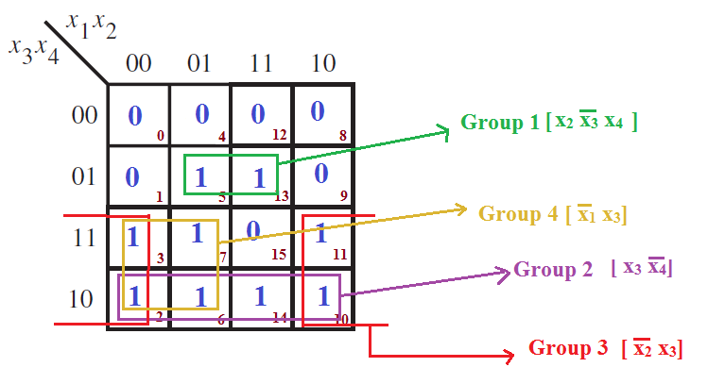
Step 4: Check for quads and octets of adjacent 1’s even if it contains some 1’s that have already been circled.While doing this make sure that minimum number of groups.

Slide 16

Step 5 : Combine any pairs necessary to include any 1’s that have not yet been grouped.
Step 6: Form the simplified expression by summing product terms of all the groups.

Slide 17

Simplification of Product of Sum expression
Simplify the following expression using the Karnaugh map
for the 4 variables x_{1,} x₂ , x₃ and x₄ .

Slide 18
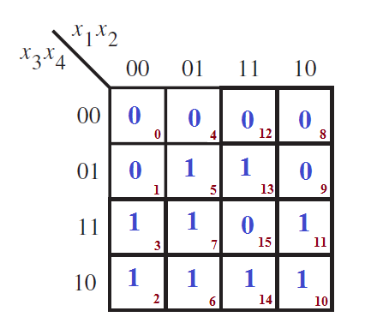
Step 1: Construct the K-map and enter 0 in the cells corresponding to the maxterms present in the expression and 1 in the other cells.

Slide 19
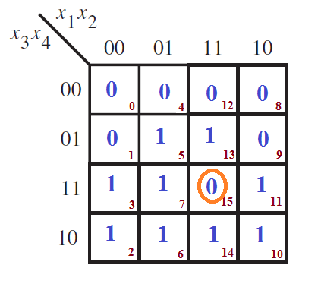
Step 2: Check the K-map for the adjacent 0’s and encircle those 0’s which are not adjacent to any other 0’s. These are called isolated 0’s.

Slide 20
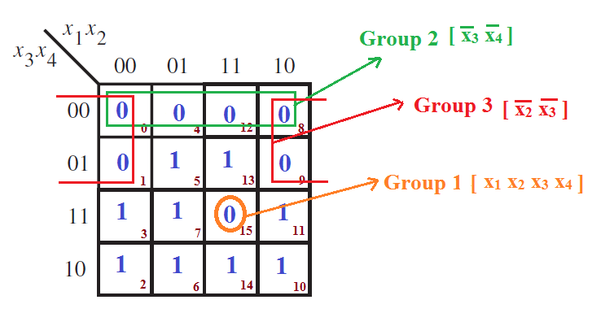
Step 3: Check for those 0’s which are adjacent to only one other 0 and encircle such pairs.
Step 4: Check for quads and octets of adjacent 0’s even if it contains some 0’s that have already been circled. While doing this make sure that minimum number of groups.

Slide 21
Step 5 : Combine any pairs necessary to include any 0’s that have not yet been grouped.
Here all zeros are grouped

Slide 22

Step 6: Form the simplified SOP expression by summing product terms of all the groups. [ Note: The simplified expression is in the complemented form because we have grouped 0’s to simplify the expressions]

Slide 23
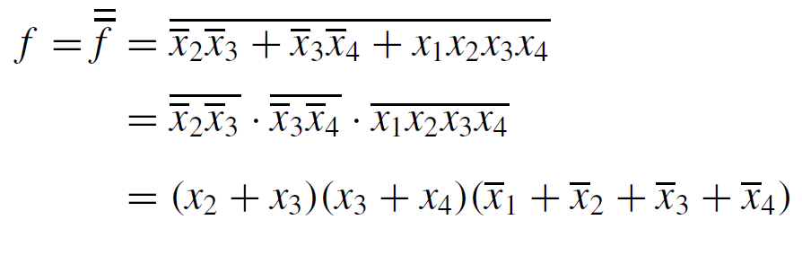
Step 7: Complementing this expression using DeMorgan’s theorem to produce the simplified expression in POS form.

Slide 24
Incompletely specified functions [Don’t care conditions]
In some logic circuits, certain input conditions never occur, therefore the corresponding output never appears.
In such cases output level is not defined, it can be either HIGH or LOW.
These output levels are marked by ‘X’ or ‘d’.
A circuit designer is free to make the output for any “don’t care” condition either a ‘0’ or ‘1’ in order to produce the simplest output expression.

Slide 25
Simplify the Boolean expression:
Where, D is the set of don’t cares.

Slide 26
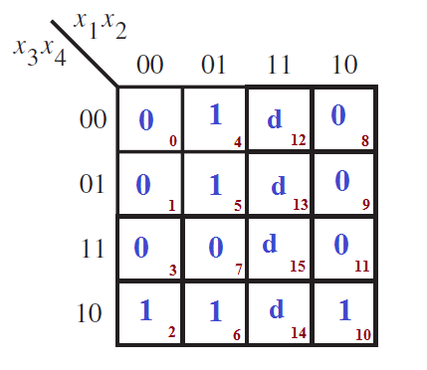

Slide 27
